Slide 1
DecodeX Hackathon N. L. Dalmia Institute of Management Studies and Research Lost in Transit: The PalletSense Challenge Team Name: Analytica
Team Member: Shruti Khapekar (Team Leader) | Sandesh Tayde | Keyur Parkhi

Slide 2
Identification of Business Problem
Background
PalletSense provides smart pallets embedded with IoT sensors to track shipments in real-time. However, due to limited GPS ping frequency (only 2-3 times per day per pallet), there are visibility gaps in tracking the pallets' movement. This results in potential losses, inefficiencies, and operational delays.
The Challenge
PalletSense is looking for an innovative approach to improve tracking without increasing the GPS ping frequency. So, Develop an approach that:
Enhances visibility into pallet journeys using analytical techniques to ensure more regular updates on locations of its pallets.
Detects deviations and generates alerts for off-route scenarios to allow adoption of pro-active intervention measures.
Notes:
Insert a map of your country.

Slide 3
Objectives
Ability to track all pallets on-route with greater regularity and reliability.
While ensuring regular updates on pallets whereabouts, identify how a deviation can be conclusively established so that alerts can be triggered.
Notes:
Insert a picture of one of the geographic features of your country.

Slide 4
Data Preparation and Availability
Known Route Repository: A collection of commonly travelled routes based on historical data, including known locations.
Ongoing Trip Data: Real-time GPS pings from pallets currently in transit.
Data Preprocessing Steps:
Converted timestamps to datetime format for proper analysis of the data.
Merged ongoing trip data with historical known routes for route adherence analysis.
Notes:
Insert a picture illustrating a season in your country.

Slide 5
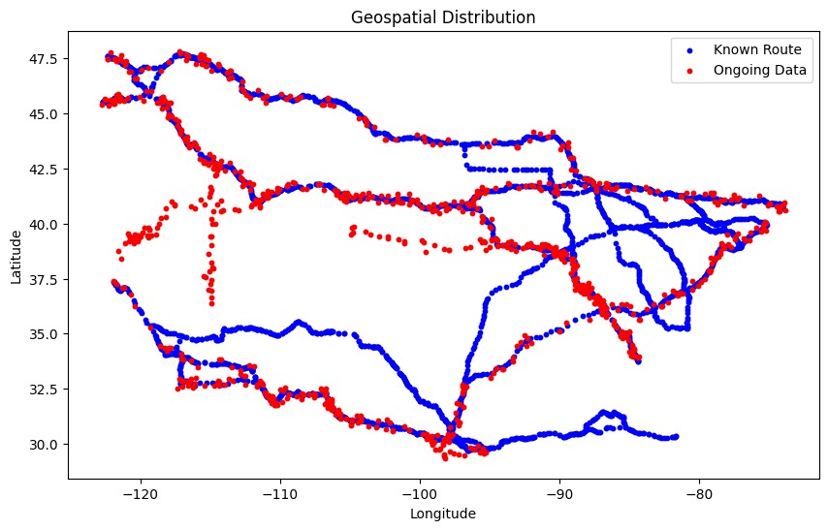
Geospatial Distribution
Interpretation: Red and Blue points overlap closely, indicating the vehicle is following the planned route.

Slide 6
Proposed Approach
To enhance pallet tracking and detect off-route movements without increasing GPS ping frequency, we propose a hybrid approach combining spatial analysis, machine learning, and visualization techniques.
1. Route Adherence Analysis (On-Route vs. Off-Route Detection)
2. Anomaly Detection Using Machine Learning
3. Pallets Travelling on Same Route
4. Detecting Stationary Pallets
Notes:
Insert a picture of an animal and or plant found in your country.

Slide 7
Route Adherence Analysis
The pallet route analysis employs a nearest-neighbour search algorithm using a cKDTree spatial index. This index is built from the latitude and longitude coordinates of the established route. For each pallet in the ongoing data, the algorithm identifies the closest point on the known route and calculates the distance between them. If this distance exceeds a predefined threshold (approximately 10,20 and 30km), the pallet is flagged as off-route, indicating a potential deviation. The results are visualized on a Folium map, distinguishing on-route and off-route pallets with distinct markers.
Notes:
Add key points in the history of your country to the timeline.

Slide 8
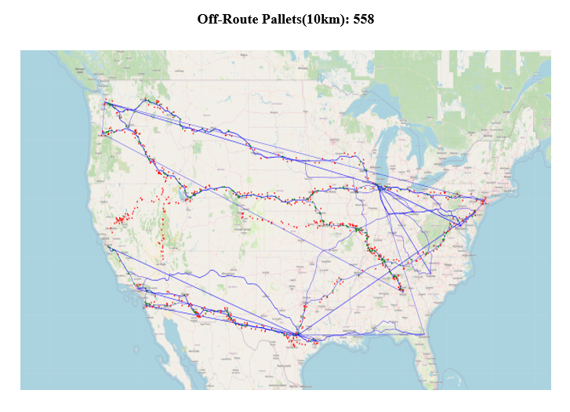
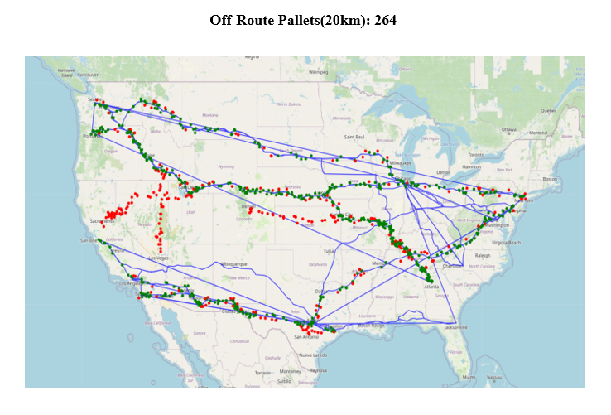
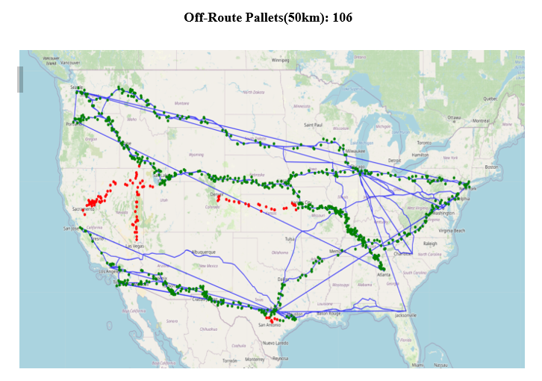
Known Routes → Plotted as a continuous blue line On-Route Pallets → Small green circles Off-Route Pallets → Small red circles
Notes:
Insert a picture illustrating a custom or tradition here.

Slide 9
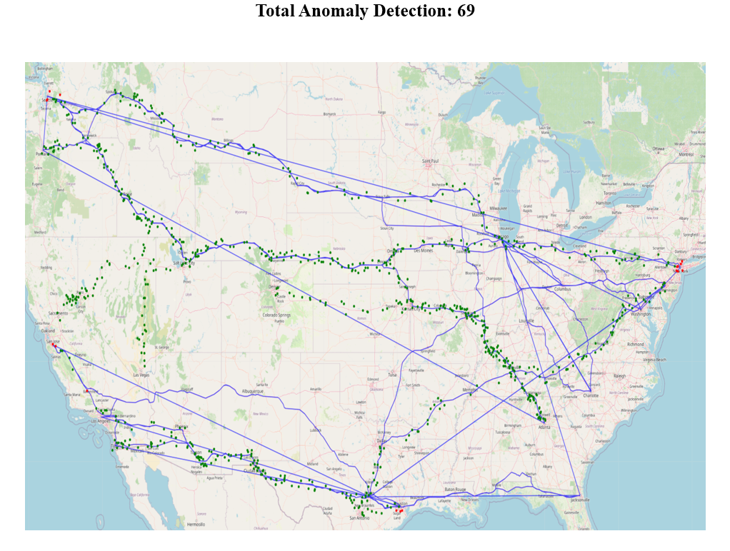
Anomaly Detection Using Machine Learning
This approach combines Isolation Forest and Haversine distance. Isolation Forest detects unusual GPS patterns, flagging potential anomalies. Haversine distance verifies these anomalies by measuring their distance from known routes. Pallets flagged as anomalous and exceeding a distance threshold are identified as true route deviations, enhancing detection accuracy.
Notes:
Insert a picture of the head leader of your country.

Slide 10
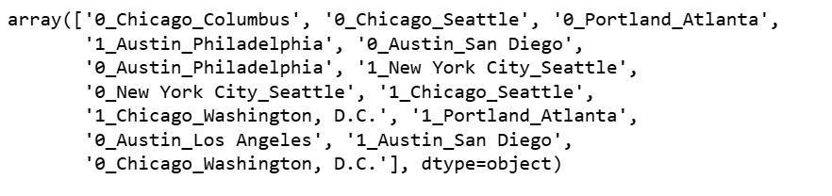
Known Routes Followed by the Pallet
Notes:
Insert a picture that illustrates some part of your country’s economy.

Slide 11
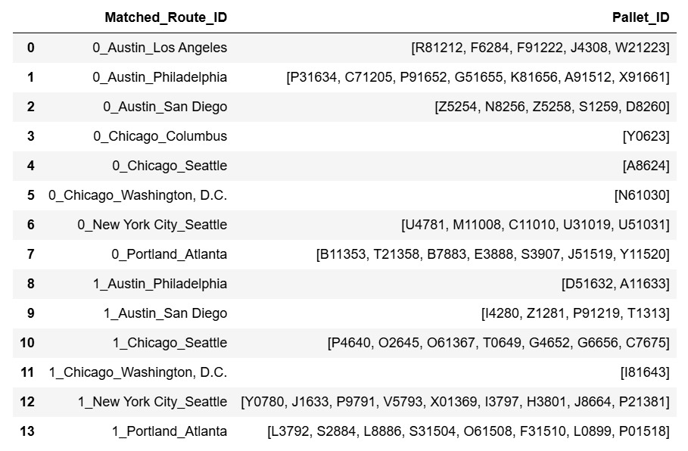
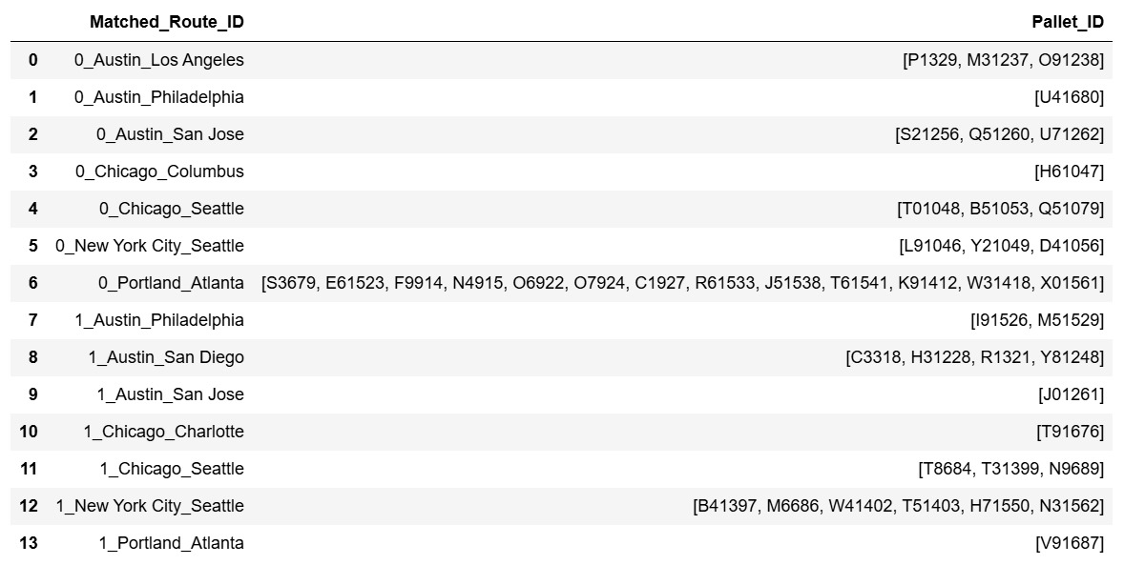

Pallets Travelling Together
Make different data sets for different values of first occurrence of Pallet by the Date.
Compare the coordinates of the historic and the real time data.
Date: 05-09-2024
Date: 06-09-2024
Date: 07-09-2024
Notes:
Insert a picture of one of the points of interest for your country.

Slide 12
Detecting Stationary Pallet
We assumed if the speed is less than 20km/hr then at some point the pallet was stationary on that route. i.e. if it is travelling this much slow it is possible that it has to identify pallets that are stuck at a location.
Most Frequent Route
1. 0_Chicago Seattle (Frequent) Pallets are A8624,T01048, B51053, Q51079
2. 0_New York City_Seattle Pallets are L91046, Y21049, D41056,U4781, M11008, C11010, U31019, U51031
3. 0_Austin_Philadelphia Pallets are P31634, C71205, P91652, G51655, K81656, A91512, X91661,U41680
4. 0_Austin_Jacksonville
The PalletSense Company should take care when the GPS pallets that are stuck at a location, when it is travelling from “0_Chicago_Seattle”.

Slide 13
Results
Route Adherence Analysis
Using a spatial nearest-neighbour approach (cKDTree), off-route pallets were identified based on distance thresholds.
Comparing number of Off-route pallet counts based of 10km, 20km & 50km.
Anomaly Detection with Machine Learning
The Isolation Forest algorithm identified 69 anomalies, with Haversine distance which will help improving accuracy.
These anomalies represent significant route deviations and possible misroutes.
Pallets Traveling Together:
A threshold-based grouping approach identified pallets moving on the same route based on approximation criterion.
Detecting Stationary Pallets:
By analysing speed and distance variations, identified stationary pallets.
The most frequent routes with stationary pallets are 0_Chicago-Seattle

Slide 14
Conclusion
The give analytical framework enhances accuracy of tracking pallet without increasing GPS ping frequency.
The route adherence model effectively identifies deviations, allowing for proactive measures.
Grouping pallets that are traveling together can improve planning and reduce operational inefficiencies.
Identifying stationary pallets helps prevent delays and ensures timely delivery.

Slide 15
THANK YOU !!

